Slide 1
JavaScript

Slide 2
JavaScript
JavaScript is used to create client-side dynamic pages.
JavaScript is an object-based scripting language which is lightweight and cross-platform.
JavaScript Translator (embedded in the browser) is responsible for translating the JavaScript code for the web browser.
JavaScript (js) is a light-weight object-oriented programming language which is used by several websites for scripting the webpages.
It is an interpreted, full-fledged programming language that enables dynamic interactivity on websites

Slide 3
Features of JavaScript
All popular web browsers support JavaScript as they provide built-in execution environments.
JavaScript follows the syntax and structure of the C programming language.
JavaScript is an object-oriented programming language
It is a light-weighted and interpreted language.
It is a case-sensitive language.
JavaScript is supportable in several operating systems including, Windows, macOS, etc.
It provides good control to the users over the web browsers.

Slide 4
Application of JavaScript
JavaScript is used to create interactive websites. It is mainly used for:
Client-side validation,
Dynamic drop-down menus,
Displaying date and time,
Displaying pop-up windows and dialog boxes (like an alert dialog box, confirm dialog box and prompt dialog box),

Slide 5
JavaScript Example
<html>
<body>
<h2>Welcome to JavaScript</h2>
<script type="text/javascript">
document.write("Hello JavaScript ");
</script>
</body>
</html>
The document.write() function is used to display dynamic content through JavaScript.

Slide 6
Places to put JavaScript code
Between the body tag of html
Between the head tag of html
<body> <h2>Welcome to JavaScript</h2> <script type="text/javascript"> document.write("Hello JavaScript "); </script> </body> | <head> <script type="text/javascript"> document.write("Hello JavaScript "); </script> </head> <body> <p>Welcome to JavaScript</p> </body>

Slide 7
Types of JavaScript Comments
There are two types of comments in JavaScript.
1) Single-line Comment
It is represented by double forward slashes (//).
// It is single line comment
document.write("hello javascript");
2) Multi-line Comment
It can be used to add single as well as multi line comments. So, it is more convenient.
It is represented by forward slash with asterisk then asterisk with forward slash.
/* your code here */

Slide 8
JavaScript Variable
A JavaScript variable is simply a name of storage location. There are two types of variables in JavaScript : local variable and global variable.
There are some rules while declaring a JavaScript variable
Name must start with a letter (a to z or A to Z), underscore( _ ), or dollar( $ ) sign.
After first letter we can use digits (0 to 9), for example value1.
JavaScript variables are case sensitive, for example x and X are different variables.

Slide 9
Example of JavaScript variable
<html>
<body>
<script>
var x = 10;
var y = 20;
var z=x+y;
document.write(z);
</script>
</body>
</html>

Slide 10
Javascript Data Types
JavaScript provides different data types to hold different types of values. There are two types of data types in JavaScript.
Primitive data type
Non-primitive (reference) data type
JavaScript is a dynamic type language, means you don't need to specify type of the variable because it is dynamically used by JavaScript engine.
To use var here to specify the data type.
It can hold any type of values such as numbers, strings etc. For example:
var a=40;//holding number
var b=“cvsr";//holding string

Slide 11
JavaScript primitive data types
There are five types of primitive data types in JavaScript. They are as follows
Data Type | Description
String | represents sequence of characters e.g. "hello"
Number | represents numeric values e.g. 100
Boolean | represents boolean value either false or true
Undefined | represents undefined value
Null | represents null i.e. no value at all

Slide 12
JavaScript non-primitive data types
The non-primitive data types are as follows
Data Type | Description
Object | represents instance through which we can access members
Array | represents group of similar values
RegExp | represents regular expression

Slide 13
JavaScript Operators
JavaScript operators are symbols that are used to perform operations on operands.
For example:
var sum=10+20;
There are following types of operators in JavaScript.
Arithmetic Operators
Comparison (Relational) Operators
Bitwise Operators
Logical Operators
Assignment Operators

Slide 14
JavaScript If-else
The JavaScript if-else statement is used to execute the code whether condition is true or false. There are three forms of if statement in JavaScript.
If Statement
If else statement
if else if statement

Slide 15
JavaScript If statement
<html>
<body>
<script>
var a=20;
if(a>10){
document.write("value of a is greater than 10");
}
</script>
</body>
</html>

Slide 16
JavaScript If...else Statement
It evaluates the content whether condition is true of false. The syntax of JavaScript if-else statement is given below.
if(expression)
{
//content to be evaluated if condition is true
}
else
{
//content to be evaluated if condition is false
}

Slide 17
JavaScript If...else if statement
It evaluates the content only if expression is true from several expressions. The signature of JavaScript if else if statement is given below.
if(expression1){
//content to be evaluated if expression1 is true
}
else if(expression2){
//content to be evaluated if expression2 is true
}
else if(expression3){
//content to be evaluated if expression3 is true
}
else{
//content to be evaluated if no expression istrue
}

Slide 18
Example
<html>
<body>
<script>
var a=20;
if(a==10){
document.write("a is equal to 10");
}
else if(a==15){
document.write("a is equal to 15");
}
else if(a==20){
document.write("a is equal to 20");
}
else{
document.write("a is not equal to 10, 15 or 20");
}
</script>
</body>
</html>

Slide 19
JavaScript Switch
The JavaScript switch statement is used to execute one code from multiple expressions
Syntax
switch(expression)
{
case value1:
code to be executed;
break;
case value2:
code to be executed;
break;
......
default:
code to be executed if above values are not matched;
}

Slide 20
JavaScript Loops
The JavaScript loops are used to iterate the piece of code using for, while, do while or for-in loops
There are four types of loops in JavaScript.
for loop
while loop
do-while loop
for-in loop

Slide 21
1) JavaScript For loop
The JavaScript for loop iterates the elements for the fixed number of times. It should be used if number of iteration is known.
The syntax of for loop is given below.
for (initialization; condition; increment)
{
code to be executed
}
Example
<script>
for (i=1; i<=5; i++)
{
document.write(i + "<br/>")
}
</script>

Slide 22
2) JavaScript while loop
The JavaScript while loop iterates the elements for the infinite number of times. It should be used if number of iteration is not known.
The syntax of while loop is given below.
while (condition)
{
code to be executed
}
Example
<script>
var i=11;
while (i<=15)
{
document.write(i + "<br/>");
i++;
}
</script>

Slide 23
3) JavaScript do while loop
The JavaScript do while loop iterates the elements for the infinite number of times like while loop. But, code is executed at least once whether condition is true or false.
The syntax of do while loop is given below.
do{
code to be executed
}while (condition);
Example
<script>
var i=21;
do{
document.write(i + "<br/>");
i++;
}while (i<=25);
</script>

Slide 24
The for...in Loop
The for-in loop is a special type of a loop that iterates over the properties of an object, or the elements of an array. The generic
syntax of the for-in loop is:
for(variable in object)
{ // Code to be executed }
var fruits = ["Apple", "Banana", "Mango", "Orange", "Papaya"];
for(var i in fruits)
{
document.write("<p>" + fruits[i] + "</p>");
}

Slide 25
JavaScript Functions

Slide 26
A JavaScript function is a block of code designed to perform a particular task.
A JavaScript function is executed when "something" invokes it (calls it).
Syntax
A JavaScript function is defined with the function keyword, followed by a name, followed by parentheses ().
Function names can contain letters, digits, underscores, and dollar signs (same rules as variables).
The parentheses may include parameter names separated by commas: (parameter1, parameter2, ...)
The code to be executed, by the function, is placed inside curly brackets: {}
function name(parameter1, parameter2, parameter3) {
// code to be executed
}
Function Invocation
The code inside the function will execute when "something" invokes (calls) the function:
When an event occurs (when a user clicks a button)
When it is invoked (called) from JavaScript code
Automatically (self invoked)
Function Return
When JavaScript reaches a return statement, the function will stop executing.
If the function was invoked from a statement, JavaScript will "return" to execute the code after the invoking statement.
Functions often compute a return value. The return value is "returned" back to the "caller":

Slide 27
The () Operator
The () operator invokes (calls) the function:
<!DOCTYPE html>
<html>
<body>
<h1>JavaScript Functions</h1>
<p>Call a function which performs a calculation and returns the result:</p>
<p id="demo"></p>
<script>
var x = myFunction(4, 3);
document.write(x);
function myFunction(a, b) {
return a * b;
}
</script>
</body>
</html>

Slide 28
<!DOCTYPE html>
<html>
<body>
<h1>JavaScript Functions</h1>
<p>Using a function as a variable:</p>
<p id="demo"></p>
<script>
var text = "The temperature is " + toCelsius(77) + " Celsius.";
document.write (text);
function toCelsius(fahrenheit) {
return (5/9) * (fahrenheit-32);
}
</script>
</body>
</html>

Slide 29
JavaScript Objects

Slide 30
Objects in JavaScript
Object= Data along with Dynamic aspects
It is a run-time instance of a class.
ClassA
DataElements De1; De2; . .
Methods M1() M2() . .
instanceOf_classA
Objectof_classA
Object has:
All of the behavior defined in the class.
Dynamic aspects of object is in the method
‹#›

Slide 31
Example
<!DOCTYPE html>
<html>
<body>
<h2>JavaScript Objects</h2>
<script>
// Create an object:
const person = {
firstName: "John",
lastName : "Doe",
id : 5566,
fullName : function() {
return this.firstName + " " + this.lastName;
}
};
// Display some data from the object:
document.write ("person first name " + " " + person.firstName);
d
document.write ("person full name " + " " + person.fullName());
</script>
</body>
</html>

Slide 32
Document Object Model(DOM)

Slide 33
DOM Introduction
The HTML DOM is an API (Programming Interface) for JavaScript:
JavaScript can add/change/remove HTML elements
JavaScript can add/change/remove HTML attributes
JavaScript can add/change/remove CSS styles
JavaScript can react to HTML events
JavaScript can add/change/remove HTML events
The HTML DOM can be accessed with JavaScript (and with other programming languages).
In the DOM, all HTML elements are defined as objects.
The programming interface is the properties and methods of each object.
A property is a value that you can get or set (like changing the content of an HTML element).
A method is an action you can do (like add or deleting an HTML element).

Slide 34
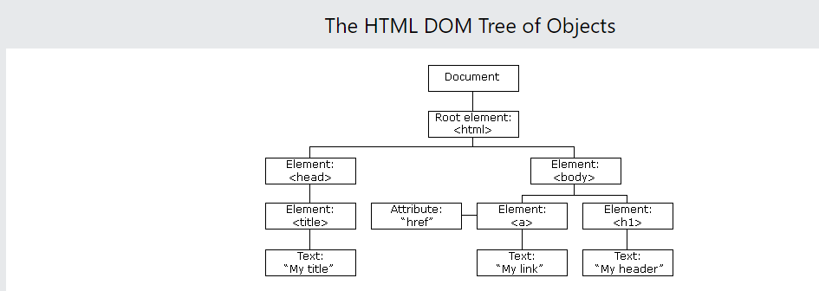
The HTML DOM (Document Object Model)
When a web page is loaded, the browser creates a Document Object Model of the page.
The HTML DOM model is constructed as a tree of Objects:

Slide 35
A document as a hierarchy of nodes
In this DOM tree, the document is the root node. The root node has one child which is the <html> element. The <html> element is called the document element.
Each document can have only one document element. In an HTML document, the document element is the <html> element. Each markup can be represented by a node in the tree.

Slide 36
Selecting elements
getElementById() – select an element by id.
getElementsByName() – select elements by name.
getElementsByTagName() – select elements by a tag name.
getElementsByClassName() – select elements by one or more class names.

Slide 37
Select an element by id
The following example changes the content (the innerHTML) of the <p> element with id="demo"
<!DOCTYPE html>
<html>
<body>
<h2>My First Page</h2>
<p id="demo"></p>
<script>
document.getElementById("demo").innerHTML = "Hello World!";
</script>
</body>
</html

Slide 38
Javascript - document.getElementsByName() method
The document.getElementsByName() method returns all the element of specified name.
syntax
document.getElementsByName("name")
<html>
<script type="text/javascript">
function totalelements()
{
var text=document.getElementsByName("gender").length;
alert("Total Genders:"+text);
}
</script>
<body>
<form>
Male:<input type="radio" name="gender" value="male">
Female:<input type="radio" name="gender" value="female">
<input type="button" onclick="totalelements()" value="Total Genders">
</form>
</body>
</html>

Slide 39
Javascript - document.getElementsByTagName() method
The document.getElementsByTagName() method returns all the element of specified tag name.
syntax
document.getElementsByTagName("name")
<!DOCTYPE html>
<html>
<body>
<h1>The Document Object</h1>
<h2>The getElementsByTagName() Method</h2>
<p>This is a paragraph.</p>
<p>This is a paragraph.</p>
<p>This is a paragraph.</p>
<script>
document.getElementsByTagName("p")[0].innerHTML = "Hello World!";
</script>
</body>
</html>

Slide 40
GetElementsByClassName()
The getElementsByClassName() method is used for selecting or getting the elements through their class name value.
This DOM method returns an array-like object that consists of all the elements having the specified classname
On calling the getElementsByClassName() method on any particular element, it will search the whole document and will return only those elements which match the specified or given class name.
Syntax
var ele=document.getELementsByClassName('name');

Slide 41
GetElementsByClassName()
<html>
<head> <h5>DOM Methods </h5> </head>
<body>
<div class="Class">
This is a simple class implementation
</div>
<script type="text/javascript">
var x=document.getElementsByClassName('Class');
document.write("On calling x, it will return an arrsy-like object: <br>"+x);
</script>
</body>
</html>

Slide 42
Changing HTML using DOM
The easiest way to modify the content of an HTML element is by using the innerHTML property.
<!DOCTYPE html>
<html>
<body>
<h2>JavaScript can Change HTML</h2>
<p id="p1">Hello World!</p>
<script>
document.getElementById("p1").innerHTML = "New text!";
</script>
<p>The paragraph above was changed by a script.</p>
</body>
</html>

Slide 43
<body>
<p id="demo"></p>
<script>
document.getElementById("demo").innerHTML = "Date : " + Date();
</script>
</body>
</html>

Slide 44
Form Validation using JS
<!DOCTYPE html>
<html>
<head>
<script>
function validateForm() {
let x = document.forms["myForm"]["fname"].value;
if (x == "") {
alert("Name must be filled out");
return false;
}
}
</script>
</head>
<body>
<h2>JavaScript Validation</h2>
<form name="myForm" action="/action_page.php" onsubmit="return validateForm()" method="post">
Name: <input type="text" name="fname">
<input type="submit" value="Submit">
</form>
</body>
</html>

Slide 45
<!DOCTYPE html>
<html>
<body>
<h2>JavaScript Validation</h2>
<p>Please input a number between 1 and 10:</p>
<input id="numb">
<button type="button" onclick="myFunction()">Submit</button>
<p id="demo"></p>
<script>
function myFunction() {
// Get the value of the input field with id="numb"
let x = document.getElementById("numb").value;
// If x is Not a Number or less than one or greater than 10
let text;
if (isNaN(x) || x < 1 || x > 10) {
text = "Input not valid";
} else {
text = "Input OK";
}
document.getElementById("demo").innerHTML = text;
}
</script>
</body>
</html>

Slide 46
Changing CSS using DOM
<!DOCTYPE html>
<html>
<head>
<style>
#p2{color:red}
</style>
</head>
<body>
<h2>JavaScript HTML DOM</h2>
<p>Changing the HTML style:</p>
<p id="p1">Hello World!</p>
<p id="p2">Hello World!</p>
<script>
document.getElementById("p2").style.color = "blue";
document.getElementById("p2").style.fontFamily = "Arial";
document.getElementById("p2").style.fontSize = "larger";
</script>
</body>
</html>

Slide 47
<!DOCTYPE html>
<html>
<body>
<h1 id="id1">My Heading 1</h1>
<button type="button"
onclick="document.getElementById('id1').style.color = 'red'">
Click Me!</button>
</body>
</html>

Slide 48
DOM Events
A JavaScript can be executed when an event occurs, like when a user clicks on an HTML element.
To execute code when a user clicks on an element, add JavaScript code to an HTML event attribute:
onclick=JavaScript
Examples of HTML events:
When a user clicks the mouse
When a web page has loaded
When an image has been loaded
When the mouse moves over an element
When an input field is changed
When an HTML form is submitted
When a user strokes a key

Slide 49
<!DOCTYPE html>
<html>
<body>
<h2>JavaScript HTML Events</h2>
<h2 onclick="changeText(this)">Click on this text!</h2>
<script>
function changeText(id) {
id.innerHTML = "Ooops!";
}
</script>
</body>
</html>

Slide 50
On-Click Event
<!DOCTYPE html>
<html>
<body>
<h2>JavaScript HTML Events</h2>
<p>Click "Try it" to execute the displayDate() function.</p>
<button id="myBtn">Try it</button>
<p id="demo"></p>
<script>
document.getElementById("myBtn").onclick = displayDate;
function displayDate() {
document.getElementById("demo").innerHTML = Date();
}
</script>
</body>
</html>

Slide 51
on-change Event
The onchange event is often used in combination with validation of input fields.
<!DOCTYPE html>
<html>
<body>
<h2>JavaScript HTML Events</h2>
Enter your name: <input type="text" id="fname" onchange="upperCase()">
<p>When you leave the input field, a function is triggered which transforms the input text to uppercase.</p>
<script>
function upperCase() {
const x = document.getElementById("fname");
x.value = x.value.toUpperCase();
}
</script>
</body>
</html>

Slide 52
On Mouse-Over
<!DOCTYPE html>
<html>
<body>
<div onmouseover="mOver(this)" onmouseout="mOut(this)"
style="background-color:#D94A38;width:120px;height:20px;padding:40px;">
Mouse Over Me</div>
<script>
function mOver(obj) {
obj.innerHTML = "Thank You"
}
function mOut(obj) {
obj.innerHTML = "Mouse Over Me"
}
</script>
</body>
</html>

Slide 53
DOM Event Listener
The addEventListener() method attaches an event handler to the specified element.
The addEventListener() method attaches an event handler to an element without overwriting existing event handlers.
You can add many event handlers to one element.
You can add many event handlers of the same type to one element, i.e two "click" events.
You can add event listeners to any DOM object not only HTML elements. i.e the window object.
The addEventListener() method makes it easier to control how the event reacts to bubbling.
When using the addEventListener() method, the JavaScript is separated from the HTML markup, for better readability and allows you to add event listeners even when you do not control the HTML markup.
You can easily remove an event listener by using the removeEventListener() method.
Syntax: element.addEventListener(event, function, useCapture);

Slide 54
<!DOCTYPE html>
<html>
<body>
<h2>JavaScript addEventListener()</h2>
<p>This example uses the addEventListener() method to execute a function when a user clicks on a button.</p>
<button id="myBtn">Try it</button>
<script>
document.getElementById("myBtn").addEventListener("click", myFunction);
function myFunction() {
alert ("Hello World!");
}
</script>
</body>
</html>

Slide 55
<!DOCTYPE html>
<html>
<body>
<h2>JavaScript addEventListener()</h2>
<p>This example uses the addEventListener() method to add many events on the same button.</p>
<button id="myBtn">Try it</button>
<p id="demo"></p>
<script>
var x = document.getElementById("myBtn");
x.addEventListener("mouseover", myFunction);
x.addEventListener("click", mySecondFunction);
x.addEventListener("mouseout", myThirdFunction);
function myFunction() {
document.getElementById("demo").innerHTML += "Moused over!<br>";
}
function mySecondFunction() {
document.getElementById("demo").innerHTML += "Clicked!<br>";
}
function myThirdFunction() {
document.getElementById("demo").innerHTML += "Moused out!<br>";
}
</script>
</body>
</html>

Slide 56
Predefined Objects
Math String Date Array Boolean Number

Slide 57
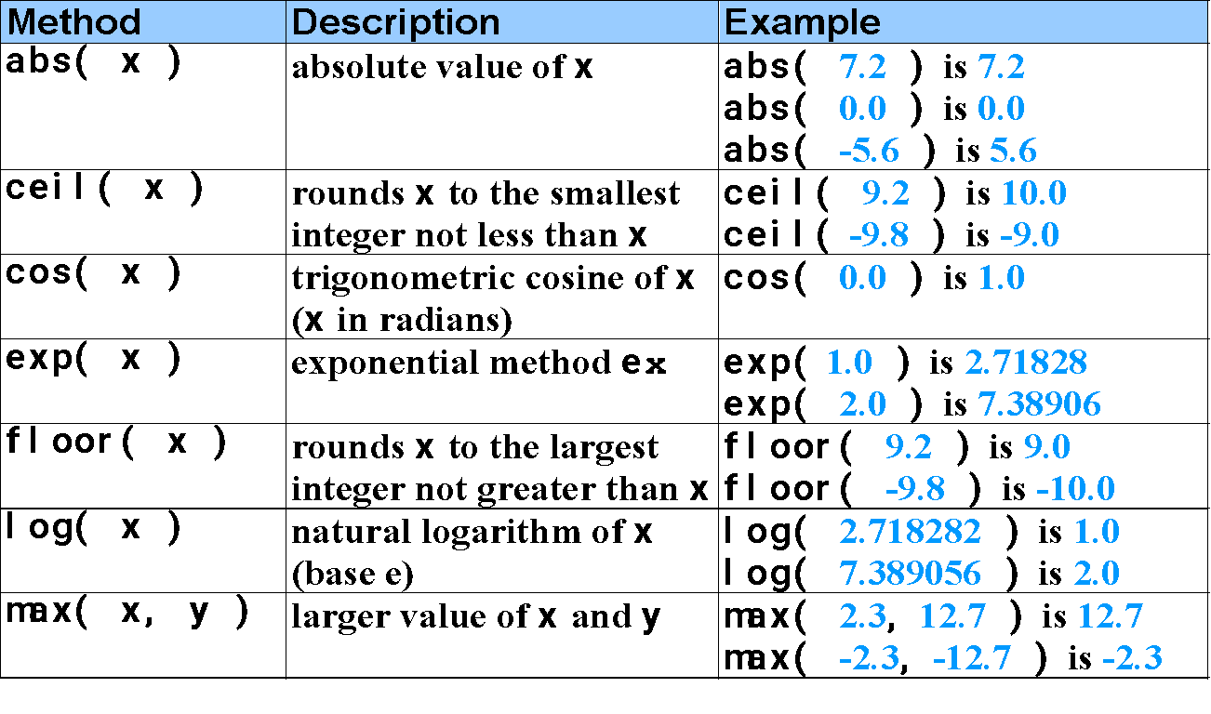
Math Object methods

Slide 58
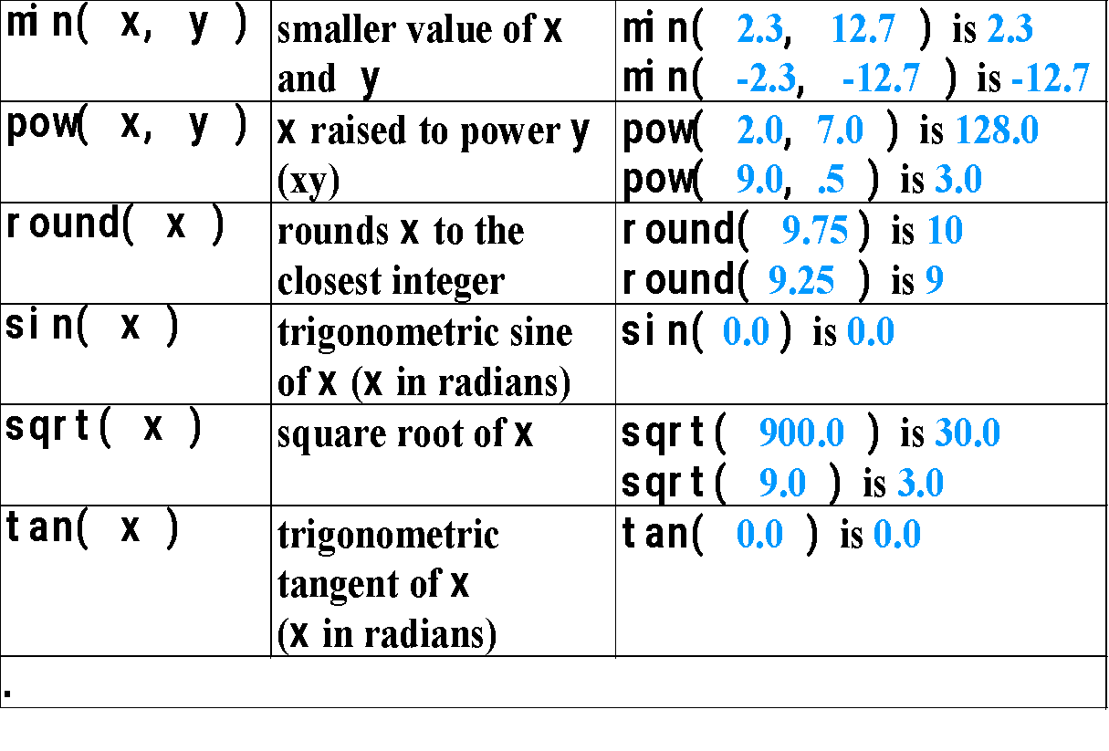
Math Object methods( contd.)

Slide 59
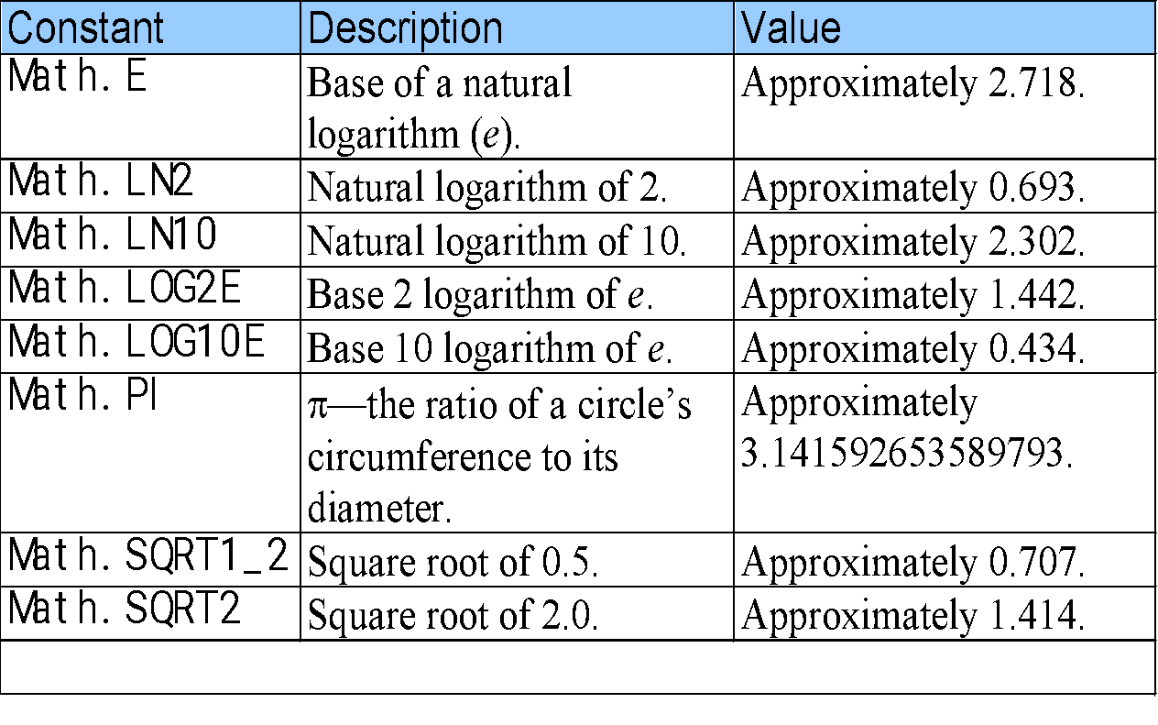
Math Object properties

Slide 60
String Object
Appropriate for processing names, addresses, credit card information, etc.
There are two ways to create String object.
i) s=“welcome”;
OR
ii) s =new String(“welcome”);

Slide 61
Fundamentals of Characters and Strings
Characters
Fundamental building blocks of JavaScript programs
String
Series of characters treated as a single unit

Slide 62
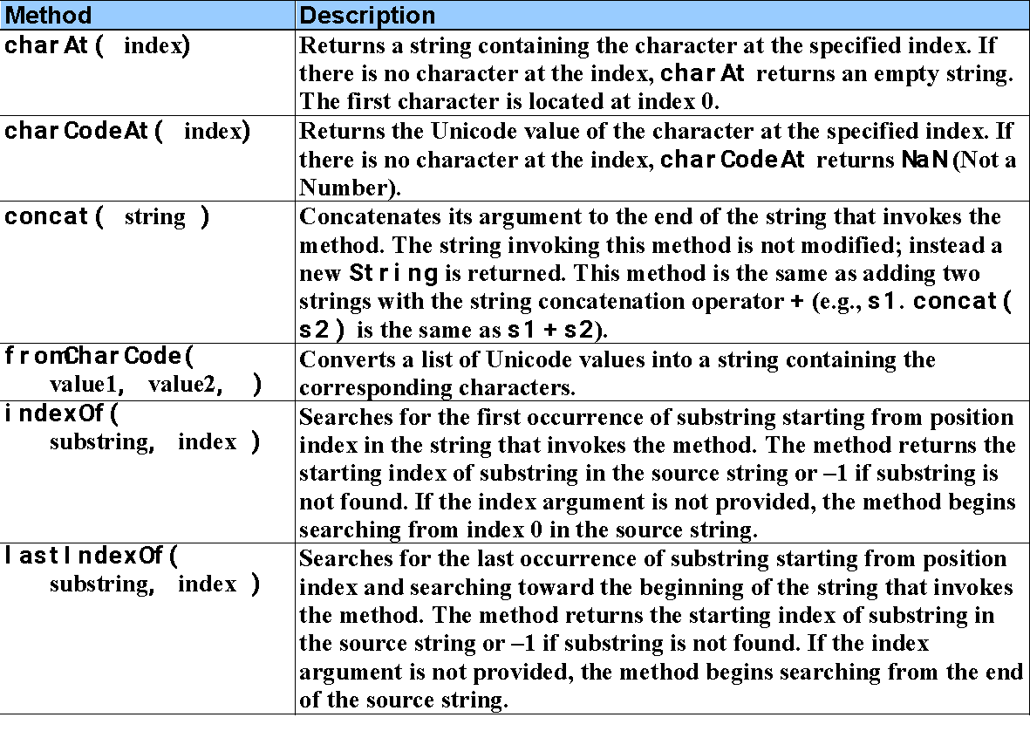
Methods of the String Object

Slide 63
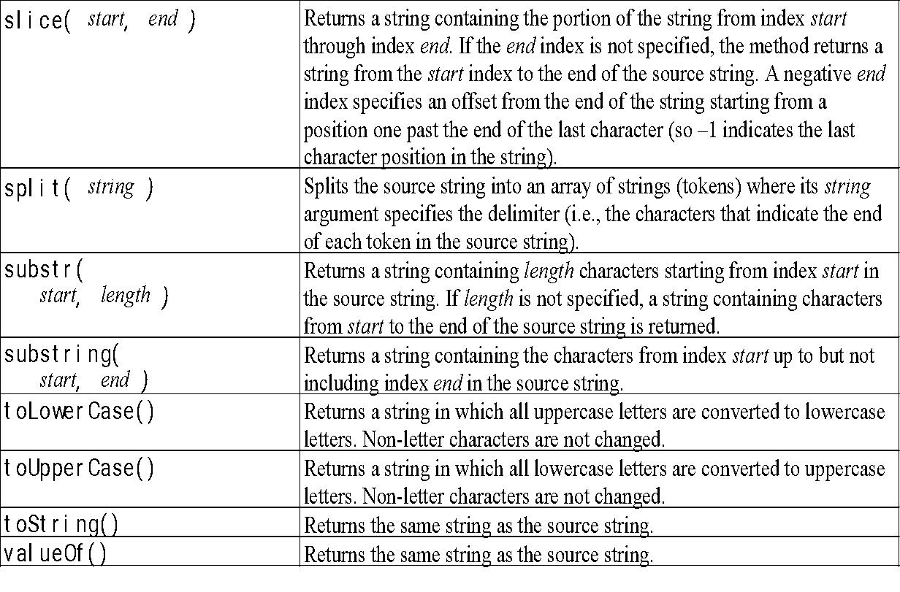
Methods of the String Object (contd)

Slide 64
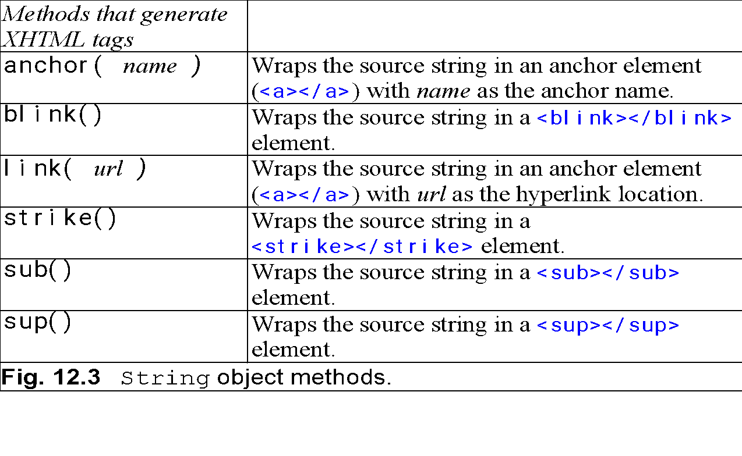
Methods of the String Object (contd.)

Slide 65
Properties of String Object
Name | Description
length | It gives the number of characters in the string.

Slide 66
Date Object
Provides methods for date and time manipulations.
There are two separate notions of time:
i) UTC :- Universal time, also known as Greenwich Mean Time.
ii) Local :- Local time is the time on the machine which is executing the script.

Slide 67
Creating Date object
There are different ways to create date object.
i) d=new Date()
ii) d=new Date(year,month,day[,hour,minute,second)
iii) d=new Date(milliseconds );
construct a new date object based upon the number of milliseconds elapsed since 00:00:00 hours on 01/01/1970.
iv) d=new Date(string )
ex:- d=new Date(“April 9, 1988 14:02.35”);

Slide 68
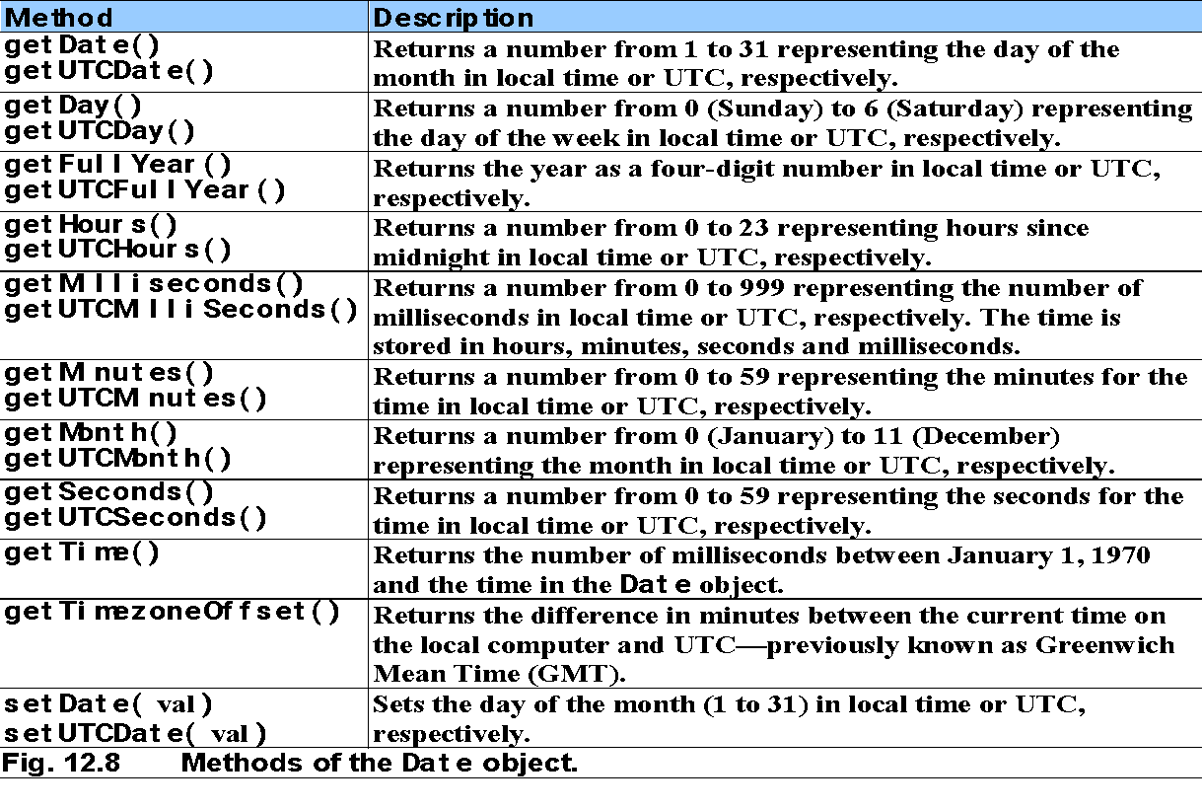
Date Object

Slide 69
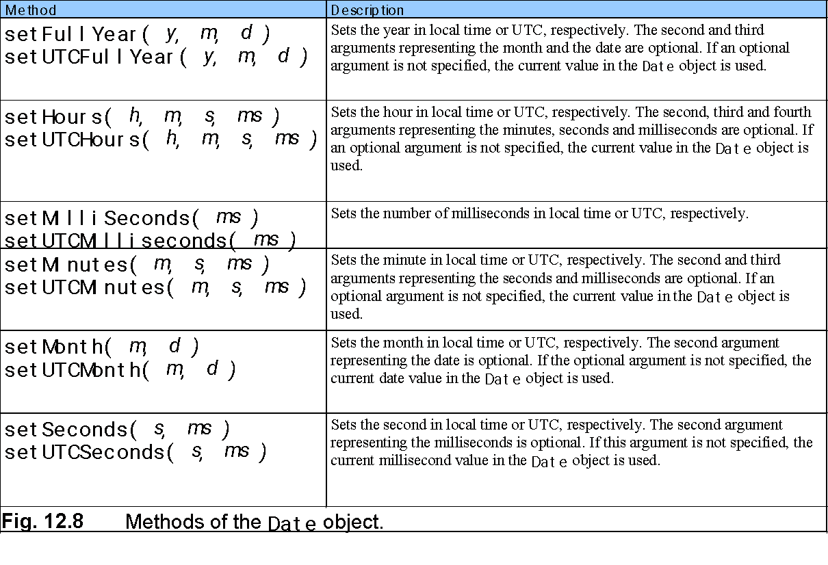
Date Object

Slide 70
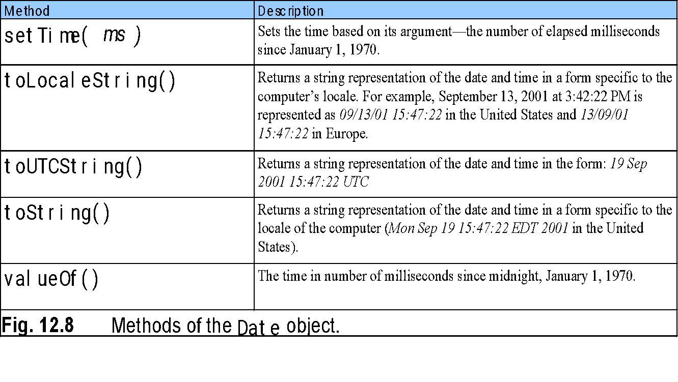
Date Object

Slide 71
Arrays
Data structures of related items
Also called Collections
Dynamic
Each element referenced by a number
Start at “zeroth element”
Subscript or index
Accessing a specific element
Name of array
Brackets
Number of element
Arrays know their length
length property

Slide 72
Arrays
Name of array
c[ 0 ]
-45
c[ 1 ]
6
c[ 2 ]
0
c[ 3 ]
72
c[ 4 ]
1543
c[ 5 ]
-89
c[ 6 ]
0
c[ 7 ]
62
c[ 8 ]
-3
c[ 9 ]
1
Position number (index
or subscript) of the
c[ 10 ]
6453
c
element within array
c[ 11 ]
78
Fig. 11.1 A 12-element array.

Slide 73
Declaring and Allocating Arrays
Arrays in memory
Objects
Operator new
Allocates memory for objects
Dynamic memory allocation operator
var c; c = new Array( 12 );

Slide 74
Examples Using Arrays
Arrays grow dynamically
Allocate more space as items are added
Must initialize array elements
Default value is undefined

Slide 75
Examples Using Arrays
Possible to declare and initialize in one step
Specify list of values
Initializer list
var n = [ 10, 20, 30, 40, 50 ]; var n = new Array( 10, 20, 30, 40, 50 );
Also possible to only initialize some values
Leave uninitialized elements blank
Uninitialized elements default to “undefined”
var n = [ 10, 20, , 40, 50 ];

Slide 76
Examples Using Arrays
for…in statement
Perform an action for each element in an array
Iterates over array elements
Ignores non-existent elements

Slide 77
Multidimensional Arrays
Two-dimensional arrays
Rows and columns
Specify row first, then column
Two subscripts

Slide 78
Multidimensional Arrays
Column 0
Column 1
Column 2
Column 3
Row 0
a[ 0 ][ 0 ]
a[ 0 ][ 1 ]
a[ 0 ][ 2 ]
a[ 0 ][ 3 ]
Row 1
a[ 1 ][ 0 ]
a[ 1 ][ 1 ]
a[ 1 ][ 2 ]
a[ 1 ][ 3 ]
Row 2
a[ 2 ][ 0 ]
a[ 2 ][ 1 ]
a[ 2 ][ 2 ]
a[ 2 ][ 3 ]
Column subscript (or index)
Row subscript (or index)
Array name
Fig. 11.12 Two-dimensional array with three rows and four columns.

Slide 79
Multidimensional Arrays
Declaring and initializing multidimensional arrays
Group by row in square brackets
Treated as arrays of arrays
Creating array b with one row of two elements and a second row of three elements:
var b = [ [ 1, 2 ], [ 3, 4, 5 ] ];

Slide 80
Multidimensional Arrays
Also possible to use new operator
Create array b with two rows, first with five columns and second with three:
var b; b = new Array( 2 ); b[ 0 ] = new Array( 5 ); b[ 1 ] = new Array( 3 );

Slide 81
Methods of Array Object
reverse()
- It reverses the order of the elements.
2. join(string)
- Creates string containing all array elements.
Specify separator

Slide 82
3. slice(start,end)
- It returns a sub-array.( excluding end argument char)
4. sort()
Defaults to string comparison
To sort numbers comparison function will be passed as an argument.
This comparison function will exchange its arguments in the array if it returns positive value.

Slide 83
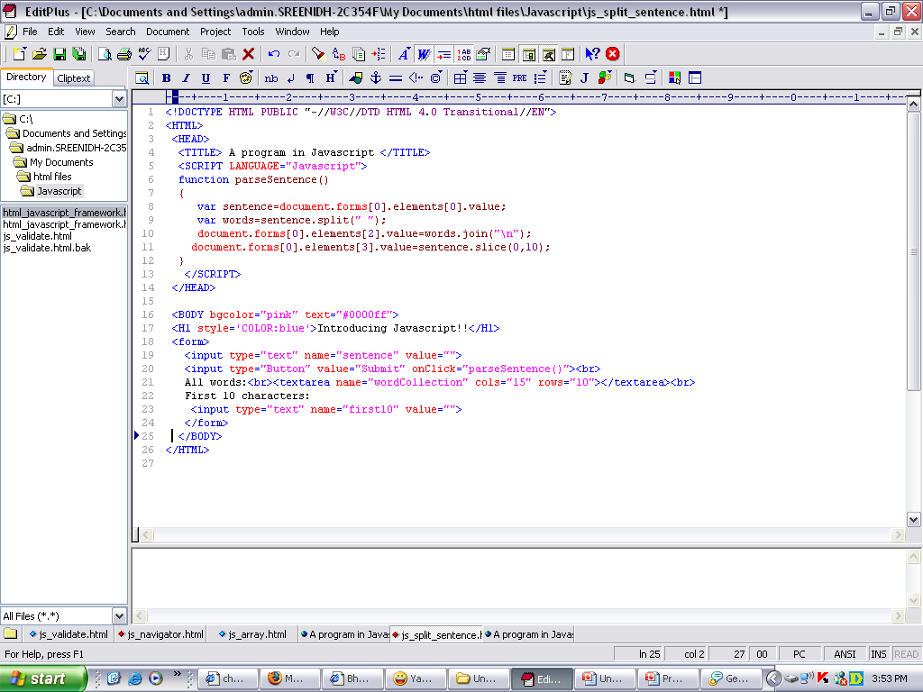
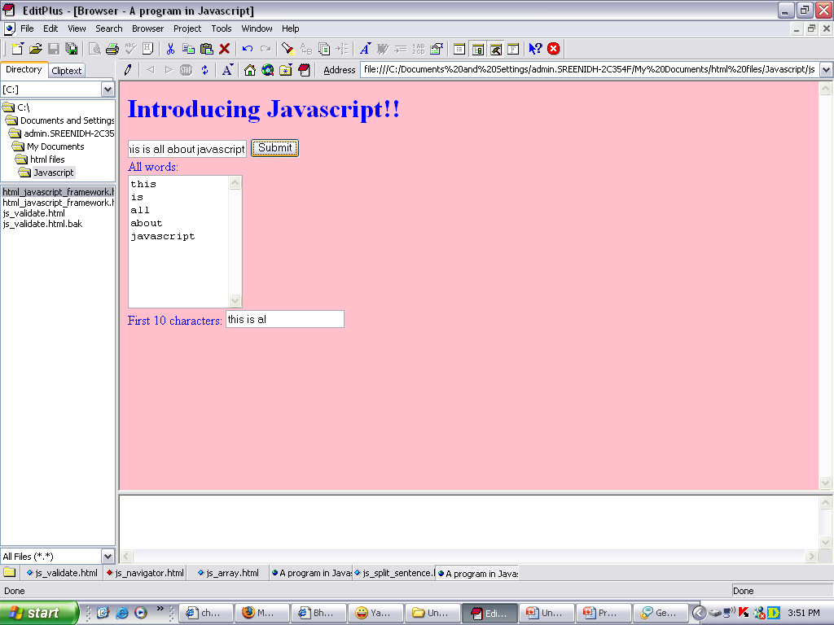
Example for Arrays and methods

Slide 84
Regular Expressions
A regular expression is a pattern of characters.
The pattern is used for searching and replacing characters in strings.
The RegExp Object is a regular expression with added Properties and Methods.
/pattern/modifier(s);
<!DOCTYPE html>
<html>
<body>
<h2>JavaScript Regular Expressions</h2>
<p>Do a case-insensitive search for "w3schools" in a string:</p>
<p id="demo"></p>
<script>
let text = "Visit W3Schools";
let pattern = /w3schools/i;
let result = text.match(pattern);
document.getElementById("demo").innerHTML = result;
</script>
</body>
</html>

Slide 85
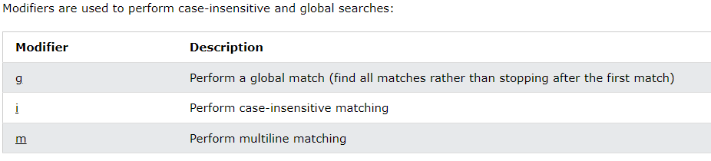
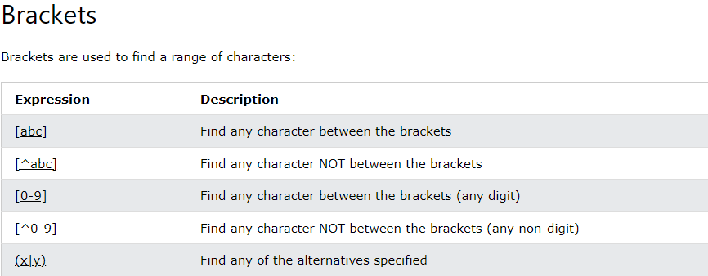
Modifiers

Slide 86
<!DOCTYPE html>
<html>
<body>
<h2>JavaScript Regular Expressions</h2>
<p>Do a global search for "is" in a string:</p>
<p id="demo"></p>
<script>
let text = "Is this all there is?";
let pattern = /is/g;
let result = text.match(pattern);
document.getElementById("demo").innerHTML = result;
</script>
</body>
</html>

Slide 87
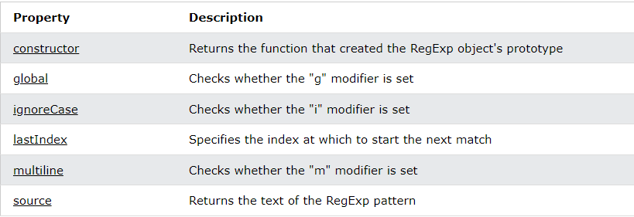
Regular Expression Object Properties

Slide 88
RegExp constructor Property
The constructor property returns the function that created the RegExp prototype.
For a regular expression the constructor property returns:
function RegExp() { [native code] }
<!DOCTYPE html>
<html>
<body>
<h2>JavaScript Regular Expressions</h2>
<p>The constructor property returns the function that created the RegExp prototype:</p>
<p id="demo"></p>
<script>
let pattern = /Hello World/g;
let text = pattern.constructor;
document.getElementById("demo").innerHTML = text;
</script>
</body>
</html>

Slide 89
JavaScript lastIndex Property
The lastIndex property specifies the index at which to start the next match.
Note: This property only works if the "g" modifier is set.
This property returns an integer that specifies the character position immediately after the last match found by exec( ) or test( ) methods.
Note: exec( ) and test( ) reset lastIndex to 0 if they do not get a match.

Slide 90
<!DOCTYPE html>
<html>
<body>
<h2>JavaScript Regular Expressions</h2>
<p>The lastIndex property specifies the index at which to start the next match:</p>
<p id="demo"></p>
<script>
let text = "The rain in Spain stays mainly in the plain";
let pattern = /ain/g;
let result = "";
while (pattern.test(text)==true) {
result += "Found at position " + pattern.lastIndex + "<br>";
}
document.getElementById("demo").innerHTML = result;
</script>
</body>
</html>

Slide 91
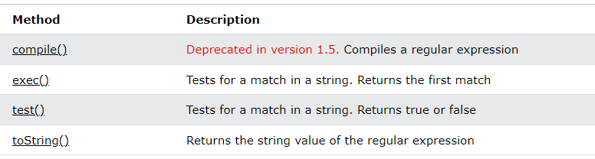
Regular Expression Object Methods

Slide 92
JavaScript RegExp exec()
The exec() method tests for a match in a string.
If it finds a match, it returns a result array, otherwise it returns null.
<!DOCTYPE html>
<html>
<body>
<h2>JavaScript RegExp</h2>
<p>The exec() method tests for a match in a string:</p>
<p>Search a string for the character "e":</p>
<p id="demo"></p>
<script>
let text = "The best things in life are free";
let result = /e/.exec(text);
document.getElementById("demo").innerHTML = result;
</script>
</body>
</html>

Slide 93
<!DOCTYPE html>
<html>
<body>
<h2>JavaScript Regular Expressions</h2>
<p>The exec() method tests for a match in a string:</p>
<p id="demo"></p>
<script>
let text = "Hello world!";
// look for "Hello"
let result1 = /Hello/.exec(text);
// look for "W3Schools"
let result2 = /W3Schools/.exec(text);
document.getElementById("demo").innerHTML =
result1 + "<br>" + result2;
</script>
</body>
</html>

Slide 94
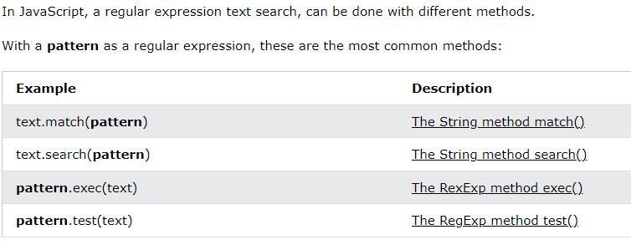
RegExp search methods

Slide 95
RegExp test method
The test() method tests for a match in a string.
If it finds a match, it returns true, otherwise it returns false.
<!DOCTYPE html>
<html>
<body>
<h2>JavaScript Regular Expressions</h2>
<p>The test() method returns true if it finds a match, otherwise false.</p>
<p>Search a string for the character "e":</p>
<p id="demo"></p>
<script>
let text = "The best things in life are free";
let pattern = /e/;
let result = pattern.test(text);
document.getElementById("demo").innerHTML = result;
</script>
</body>
</html>

Slide 96
<!DOCTYPE html>
<html>
<body>
<h2>JavaScript Regular Expressions</h2>
<p>Do a global search for "Hello" and "W3Schools" in a string:</p>
<p id="demo"></p>
<script>
let text = "Hello world!";
// look for "Hello"
let pattern1 = /Hello/g;
let result1 = pattern1.test(text)
// look for "W3Schools"
let pattern2 = /W3Schools/g;
let result2 = pattern2.test(text);
document.getElementById("demo").innerHTML = result1 + "<br>" + result2;
</script>
</body>
</html>

Slide 97
FORM VALIDATION

Slide 98
<html>
<body>
<script>
function validateform(){
var name=document.myform.name.value;
var password=document.myform.password.value;
if (name==null || name==""){
alert("Name can't be blank");
return false;
}else if(password.length<6){
alert("Password must be at least 6 characters long.");
return false;
}
}
</script>
<body>
<form name="myform" method="post" action="http://www.javatpoint.com/javascriptpages/valid.jsp" onsubmit="return validateform()" >
Name: <input type="text" name="name"><br/>
Password: <input type="password" name="password"><br/>
<input type="submit" value="register">
</form>
</body>
</html>

Slide 99
<!DOCTYPE html>
<html>
<head>
<script type="text/javascript">
function matchpass(){
var firstpassword=document.f1.password.value;
var secondpassword=document.f1.password2.value;
if(firstpassword==secondpassword){
return true;
}
else{
alert("password must be same!");
return false;
}
}
</script>
</head>
<body>
<form name="f1" action="http://www.javatpoint.com/javascriptpages/valid.jsp" onsubmit="return matchpass()">
Password:<input type="password" name="password" /><br/>
Re-enter Password:<input type="password" name="password2"/><br/>
<input type="submit">
</form>
</body>
</html>

Slide 100
<!DOCTYPE html>
<html>
<head>
<script>
function validate(){
var num=document.myform.num.value;
if (isNaN(num)){
document.getElementById("numloc").innerHTML="Enter Numeric value only";
return false;
}else{
return true;
}
}
</script>
</head>
<body>
<form name="myform" action="http://www.javatpoint.com/javascriptpages/valid.jsp" onsubmit="return validate()" >
Number: <input type="text" name="num"><span id="numloc"></span><br/>
<input type="submit" value="submit">
</form>
</body>
</html>

Slide 101
Form validation using Regular Expressions

Slide 102
<!DOCTYPE html>
<html>
<head>
<script type="text/javascript">
function validate() {
var user = document.getElementById("c").value;
var user2 = document.getElementById("c");
var re = /^[1-9][0-9]{9}$/;
if (re.test(user)) {
alert("done");
return true;
}
else {
alert("enter 10 digits phone number");
return false;
}
}
</script>
</head>
<body bgcolor="cyan">
<h1>Email Registration</h1>
<form>
<input type="text" placeholder="contact" id="c">
<input type="submit" onclick="validate()" value="create">
</form>
</body>
</html>

Slide 103
<!DOCTYPE html>
<html>
<head>
<title>creating mailing system</title>
<script type="text/javascript">
function validate() {
var user = document.getElementById("e").value;
var user2 = document.getElementById("e");
/* var re = /^\w+([\.-]?\w+)*@\w+([\.-]?\w+)*(\.\w{2,3})+$/;*/
var re = /[a-z]*[@][a-z]*[.][com]/;
if (re.test(user)) {
alert("done");
return true;
}
else {
alert("enter valid email id ")
return false;
}
}
</script>
</head>
<body bgcolor="cyan">
<center>
<h1>Email Registration</h1>
<form>
<input type="email" placeholder="username@gmail.com" id="e">
<input type="submit" onclick="validate()" value="create">
</form>
</center>
</body>
</html>

Slide 104
Media query in CSS
Media query is a CSS technique introduced in CSS3.
It uses the @media rule to include a block of CSS properties only if a certain condition is true.
@media only screen and (max-width: 600px) {
body {
background-color: lightblue;
}
}

Slide 105
<!DOCTYPE html>
<html>
<head>
<meta name="viewport" content="width=device-width, initial-scale=1.0">
<style>
body {
background-color: lightgreen;
}
@media only screen and (max-width: 600px) {
body {
background-color: lightblue;
}
}
</style>
</head>
<body>
<p>Resize the browser window. When the width of this document is 600 pixels or less, the background-color is "lightblue", otherwise it is "lightgreen".</p>
</body>
</html>

Slide 106
<!DOCTYPE html>
<html>
<head>
<meta name="viewport" content="width=device-width, initial-scale=1.0">
<style>
body {
background-color: lightgreen;
}
@media only screen and (orientation: landscape) {
body {
background-color: lightblue;
}
}
</style>
</head>
<body>
<p>Resize the browser window. When the width of this document is larger than the height, the background color is "lightblue", otherwise it is "lightgreen".</p>
</body>
</html>

Slide 107
<!DOCTYPE html>
<html>
<head>
<meta name="viewport" content="width=device-width, initial-scale=1">
<style>
div.example {
background-color: yellow;
padding: 20px;
}
@media screen and (max-width: 600px) {
div.example {
display: none;
}
}
</style>
</head>
<body>
<h2>Hide elements on different screen sizes</h2>
<div class="example">Example DIV.</div>
<p>When the browser's width is 600px wide or less, hide the div element. Resize the browser window to see the effect.</p>
</body>
</html>

Slide 108
<!DOCTYPE html>
<html>
<head>
<meta name="viewport" content="width=device-width, initial-scale=1">
<style>
div.example {
background-color: lightgrey;
padding: 20px;
}
@media screen and (min-width: 600px) {
div.example {
font-size: 80px;
}
}
@media screen and (max-width: 600px) {
div.example {
font-size: 30px;
}
}
</style>
</head>
<body>
<h2>Change the font size of an element on different screen sizes</h2>
<div class="example">Example DIV.</div>
</body>
</html>

